Slide 1
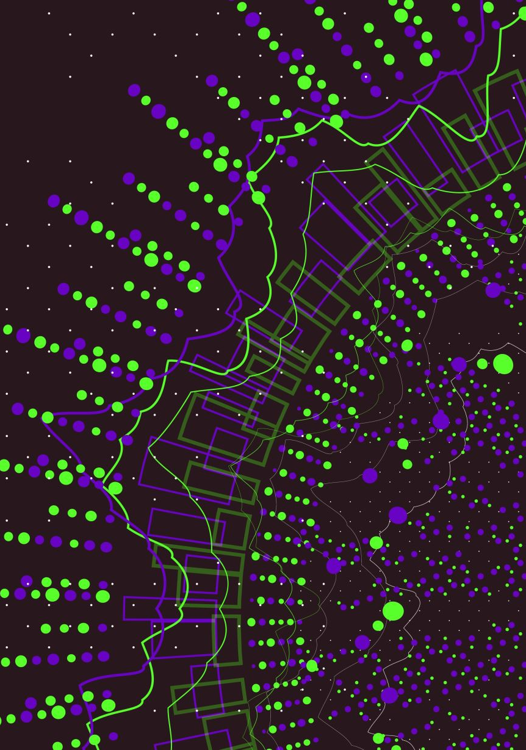

ADVENTURES IN STL DATA
2018 to NNIP Detroit
Paul Sorenson, Co-Director

Slide 2


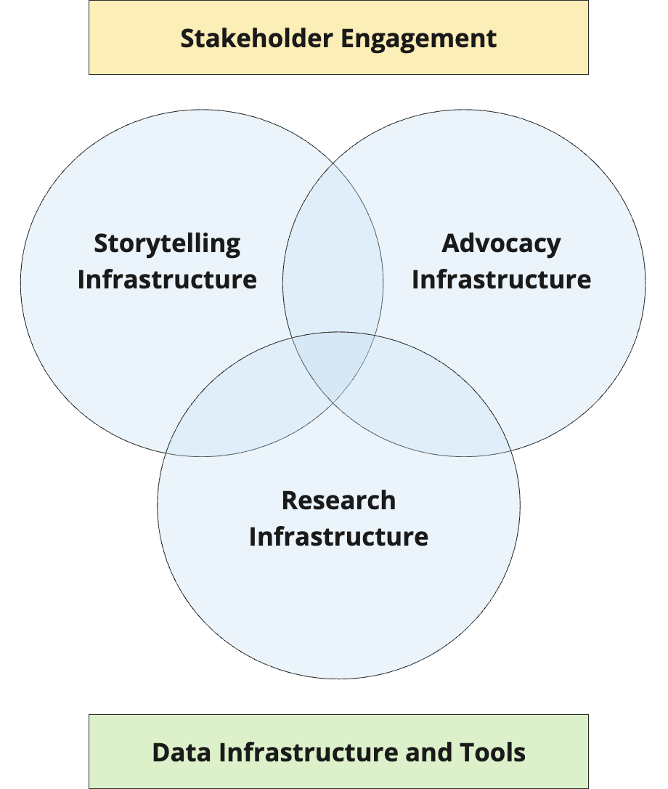

Slide 3
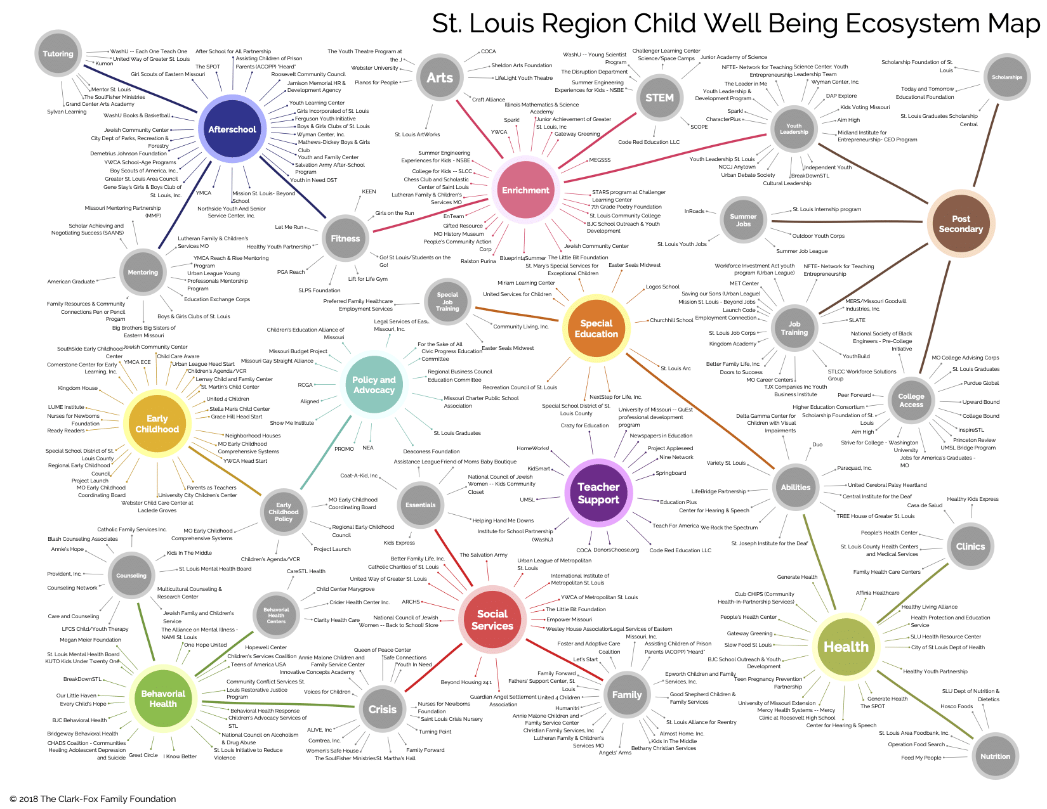

Slide 4
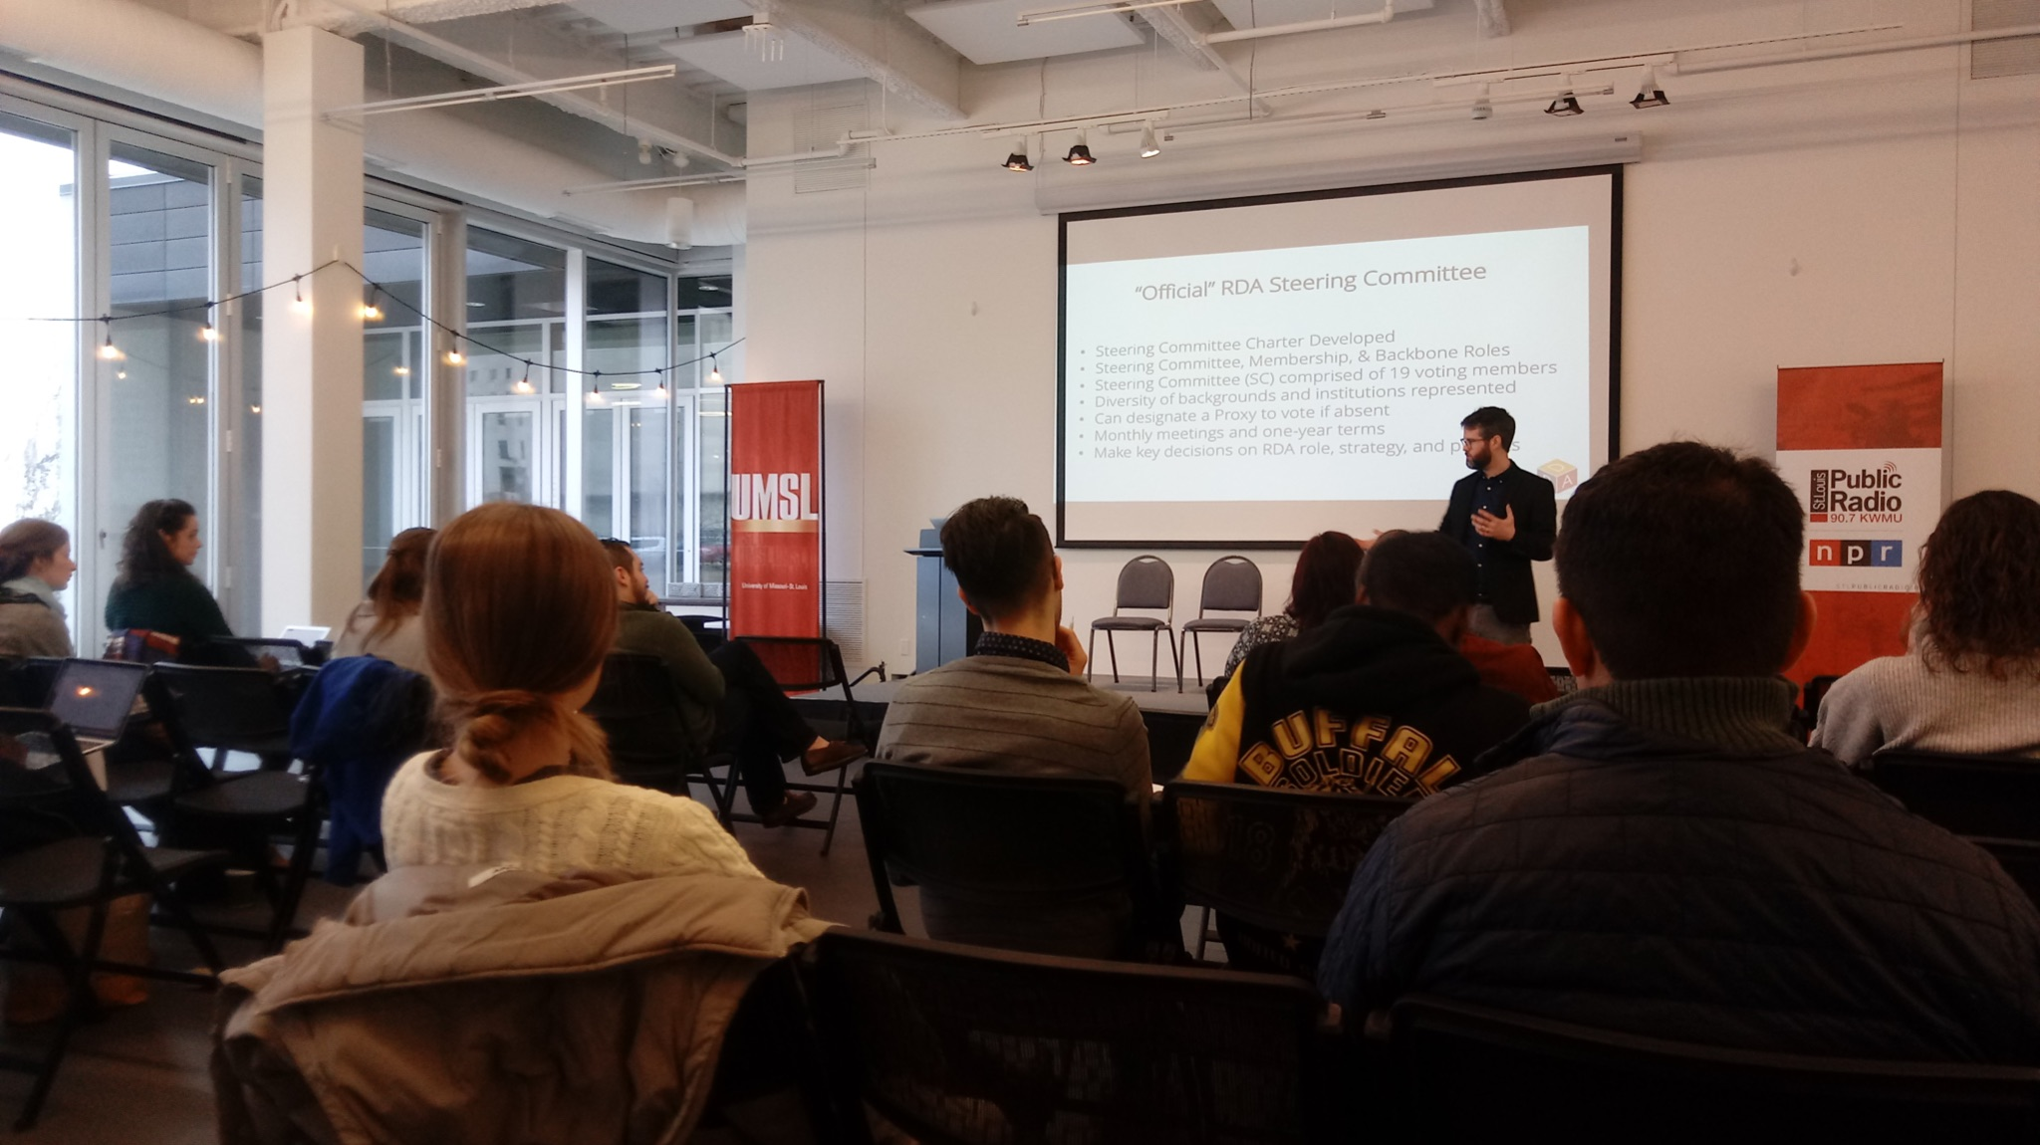

Our Mission: We build shared data infrastructure and support strong data actors that use quality data to improve people’s lives.
Notes:
Functionally: sought advice of NNIP - what were other cities doing? Oversimplified version: San Antonio organizing ARDA are people, Pittsburgh the WPRDC around data infrastructure. What if we combine them?
Spring 2018 — assembled major grant for MFH, 20+ supporting partners, received parallel to coming to UMSL, now opens up academic components of data sharing and use

Slide 5
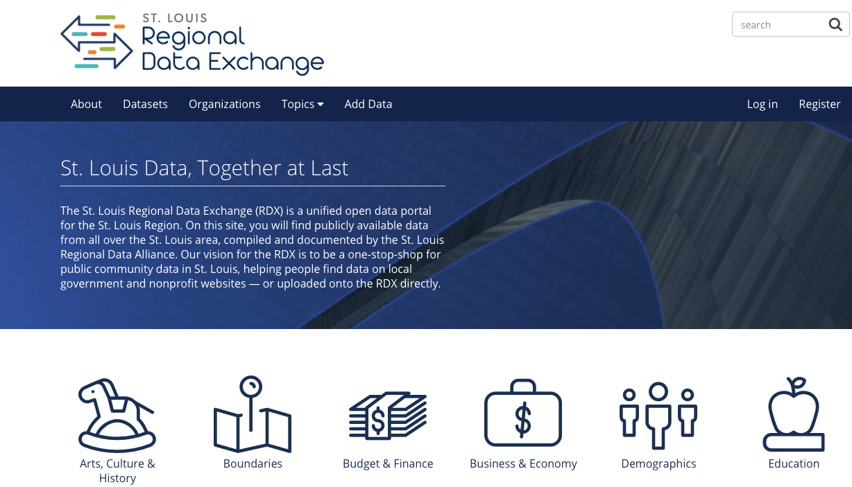
Notes:
Shifting to Infrastructure, we know that what’s currently out there about our community – largely published by governments and often, yes, quantitative or financial — still needs to be organized and accessible.

Slide 6


2020

Slide 7
Mission: We engage with community partners to co-create knowledge, connections, and tools that move us towards just, equitable, and democratic systems in the St. Louis region and beyond.
Community Engagement
Evaluation & Research
Strategy
Data
Learning

Slide 8

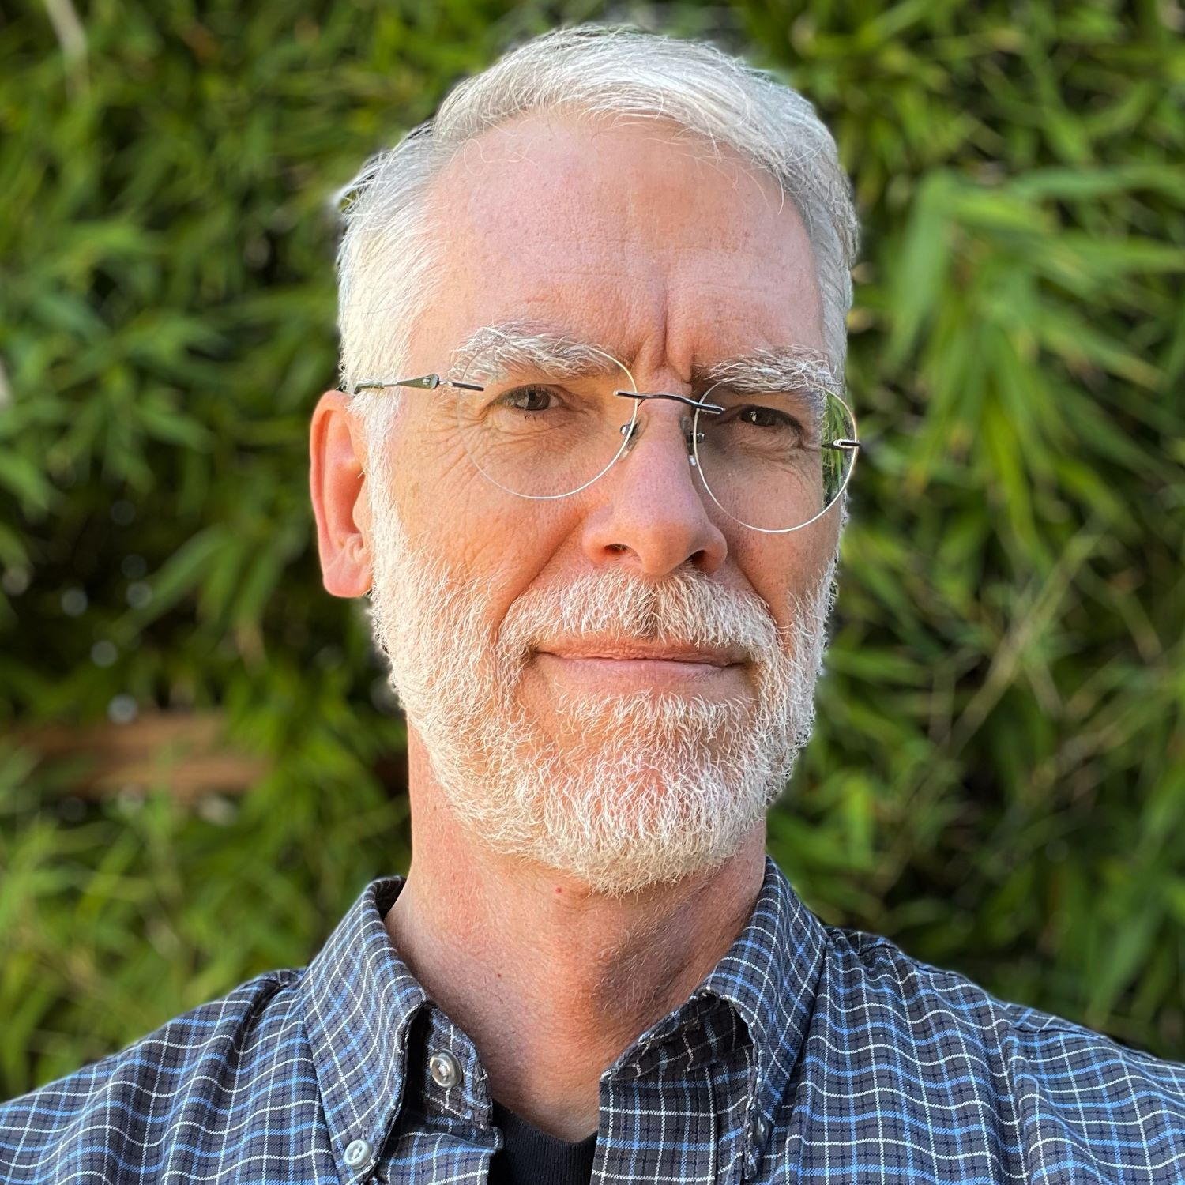




Risha Frazier, Data Strategy & Infrastructure Lead
Dave Menninger, Community Data & Application Developer
Sara Mohamed, Equity & Engagement Lead
Hanna Katz Wilking, Communications Specialist
Kalekidan Yeshiwas, Community Data Analyst
Lacey Robinson, Community Data Analyst

Slide 9

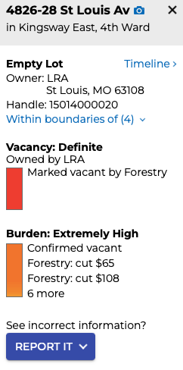
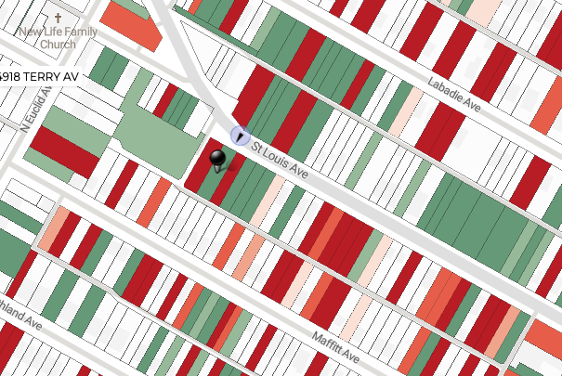
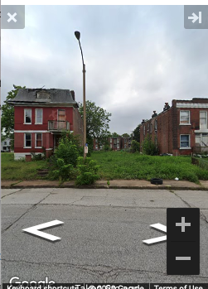
stlvacancytools.com
Notes:
The Vacancy Collaborative and Vacancy Portal is a great example of what we can do if such data is assembled. This is largely the work of folks outside of the RDA, though connected to us in a variety of ways — partners, former staff, current collaborators — that we’re trying to learn and grow from together.
(Describe vacancy portal, messiness of the data, why it’s so meaningful to know if a property is vacant or not in one place)

Slide 10
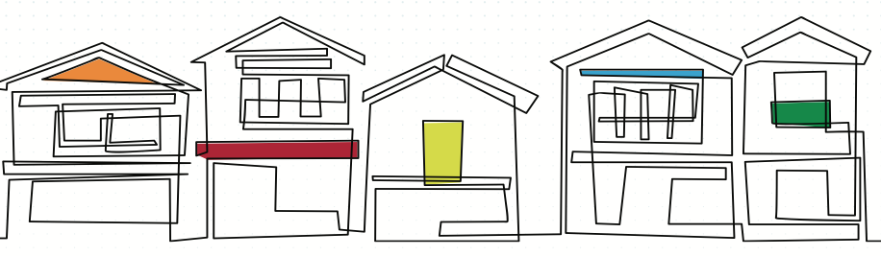
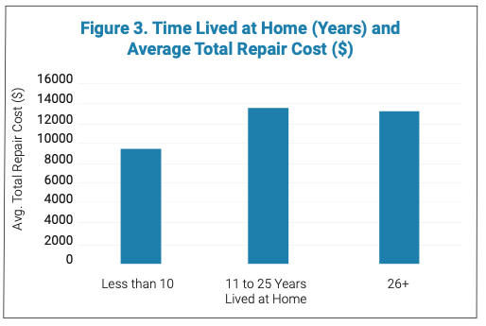
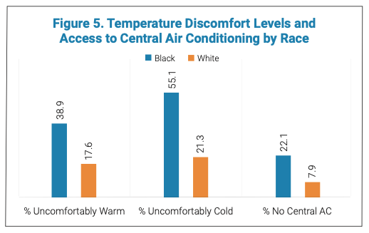
umsl.edu/ciac/homerepair.html

Slide 11
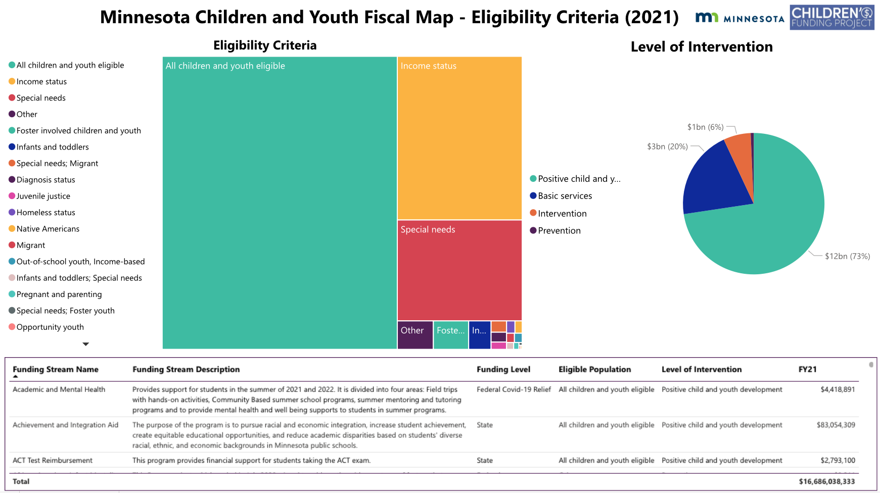
childrensfundingproject.org

Slide 12
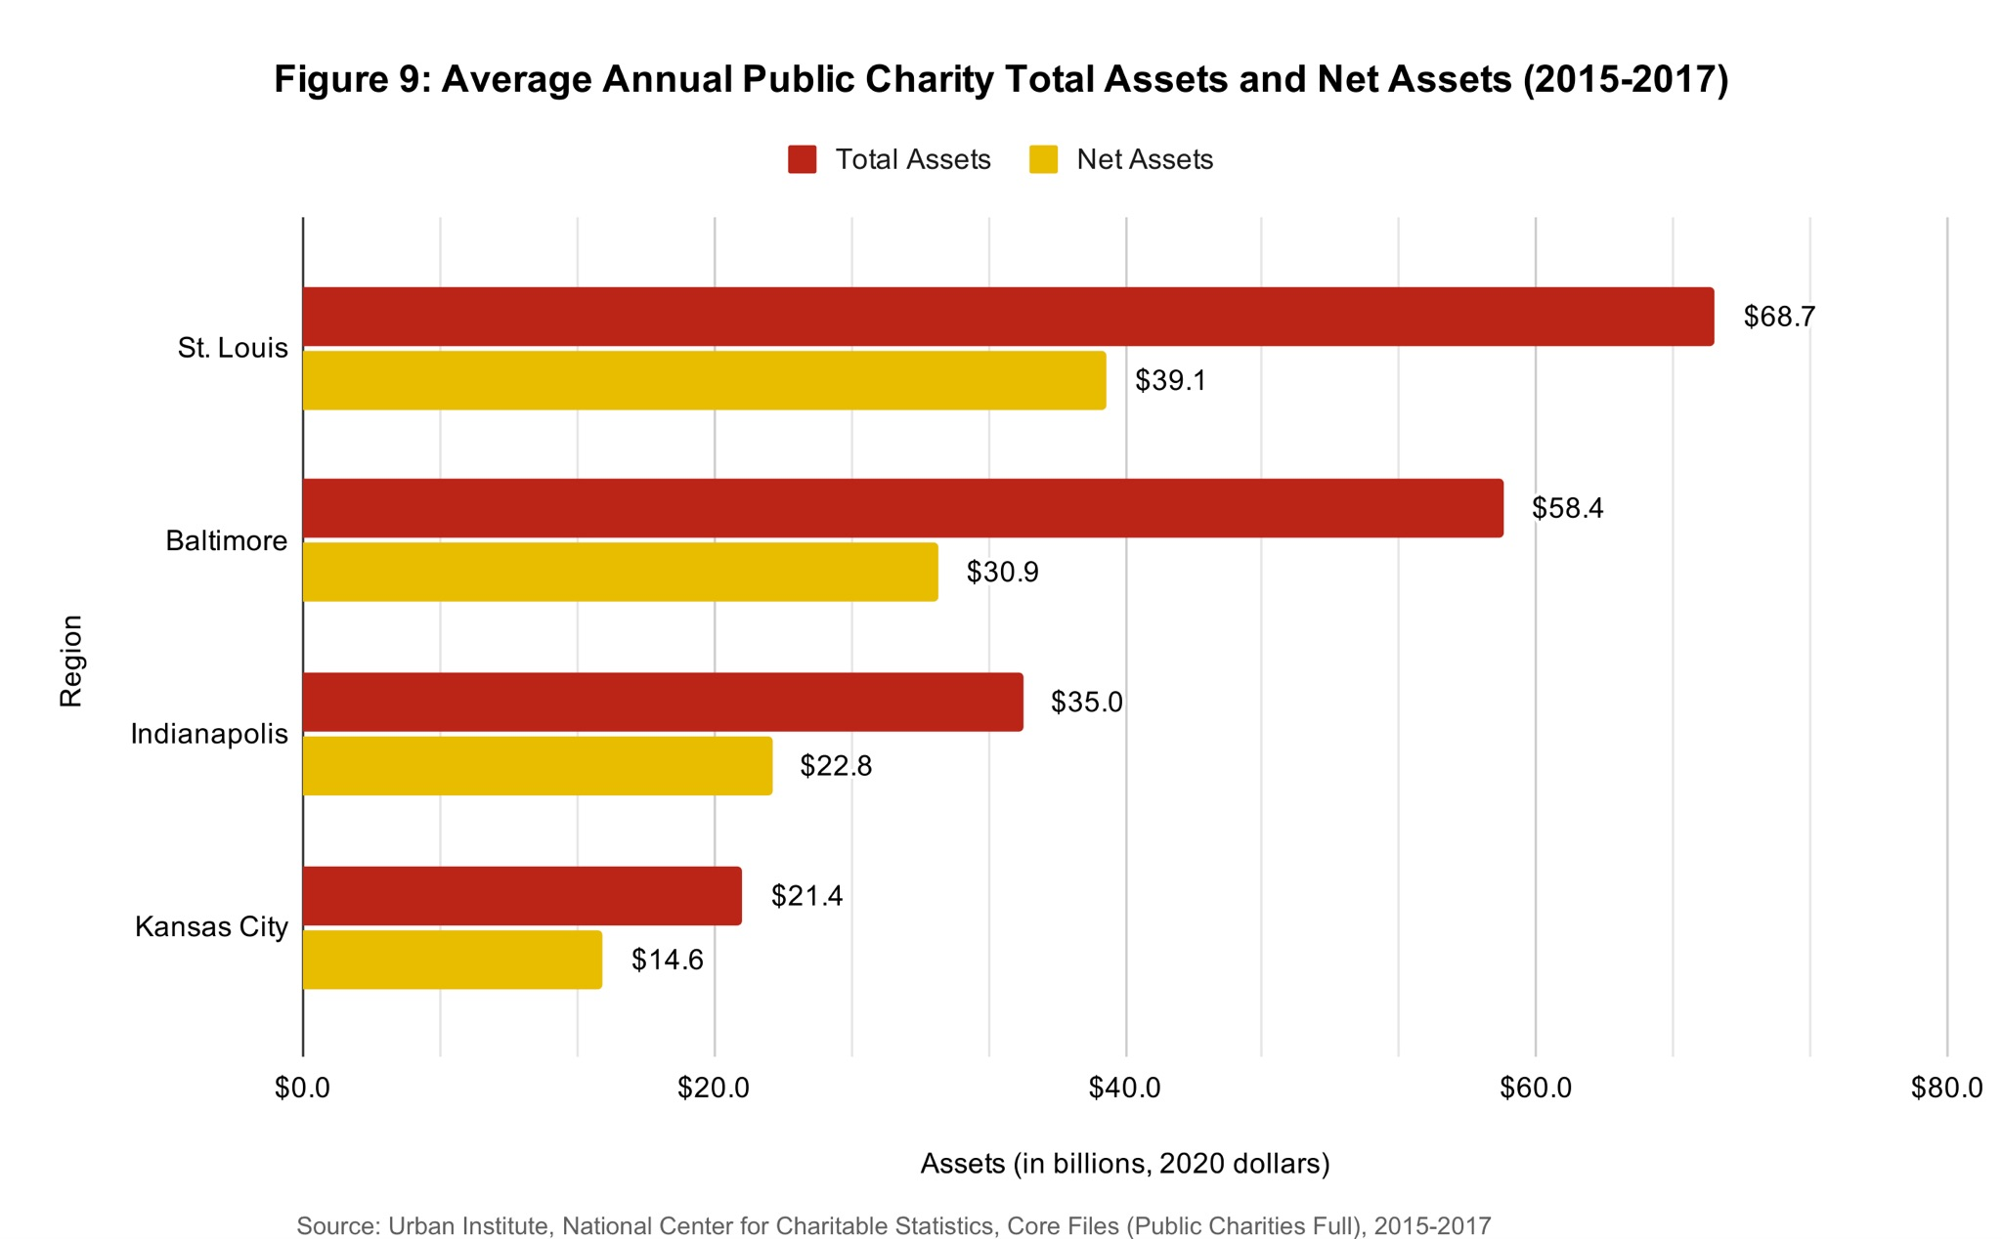

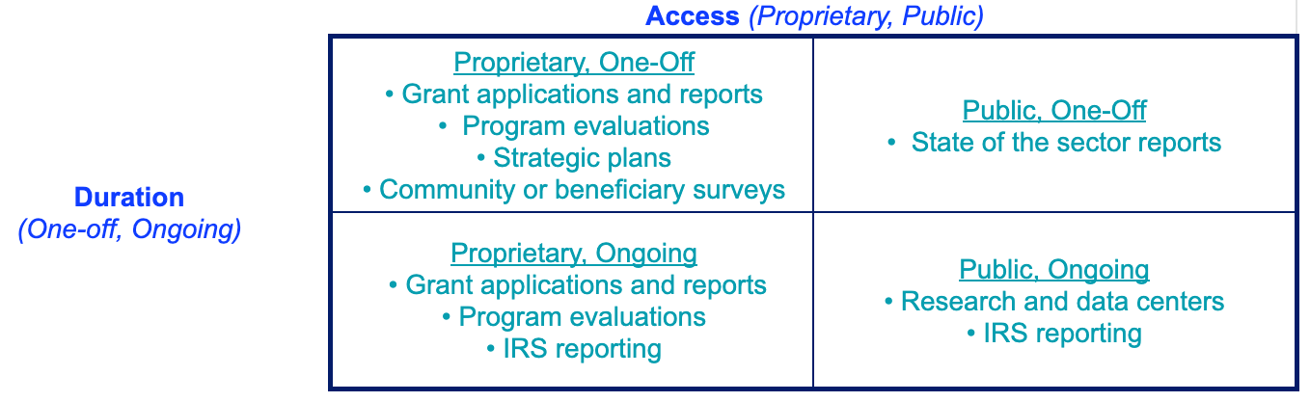

Slide 13
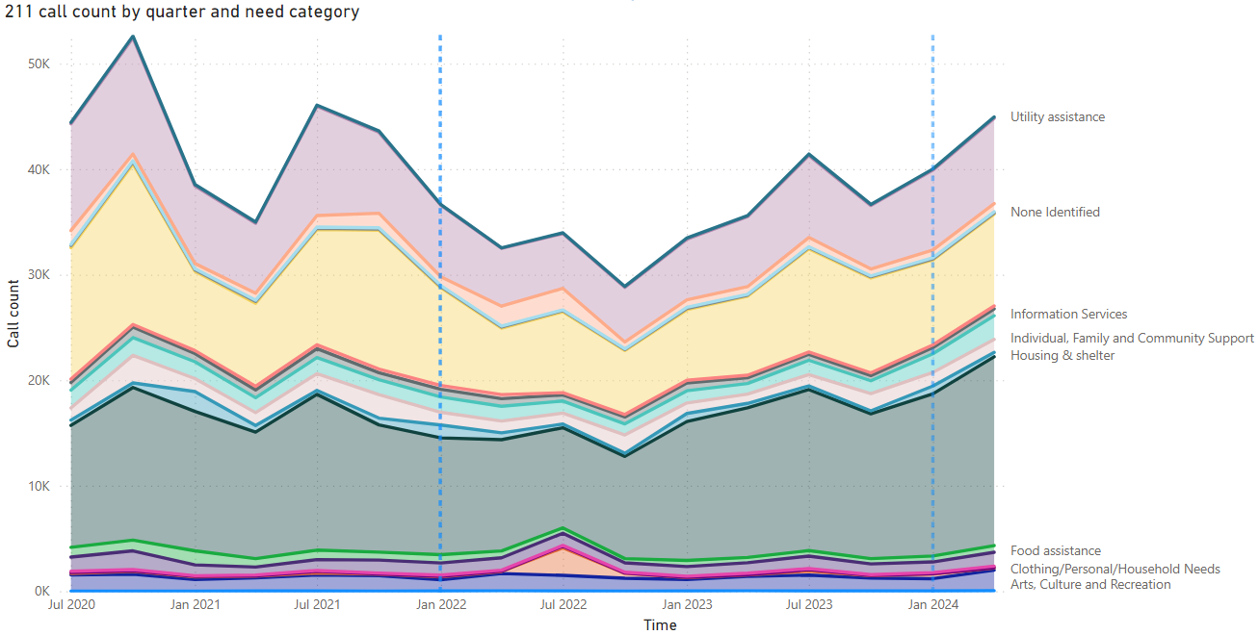



Slide 14
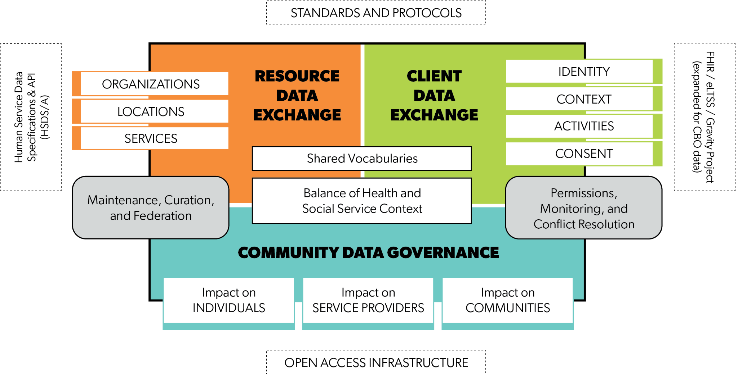
Primary Components of “Community Information Exchanges”
bit.ly/socialcaredatapdf

Slide 15
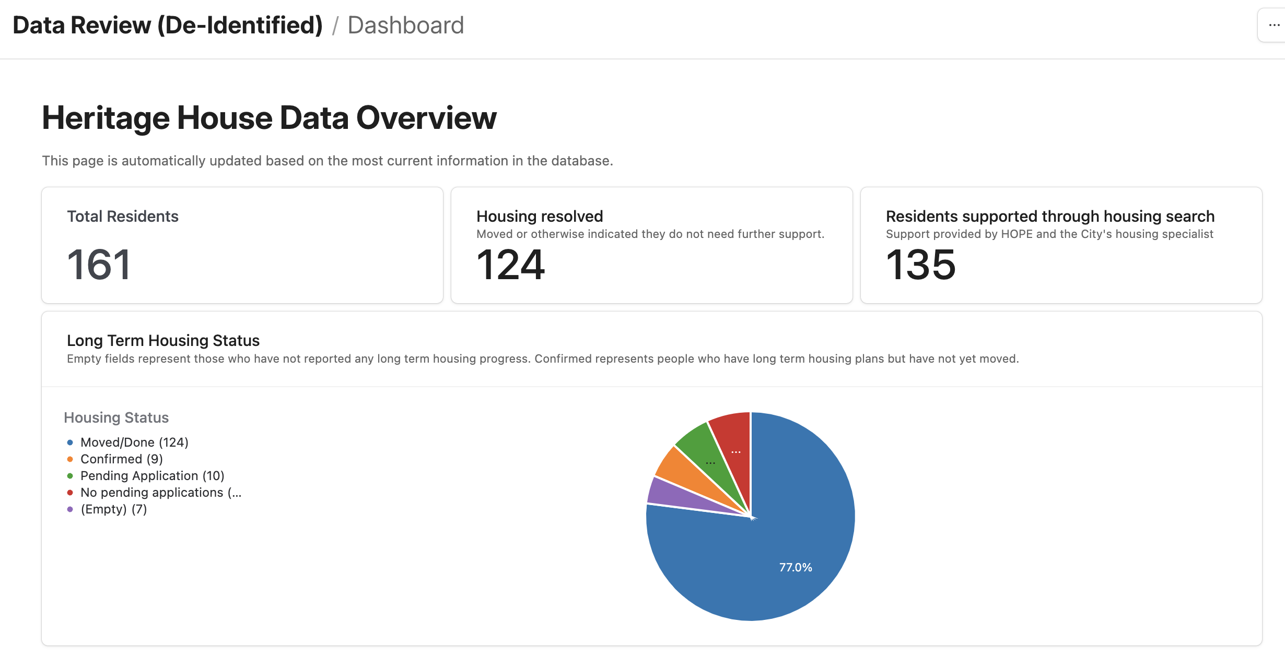


Slide 16

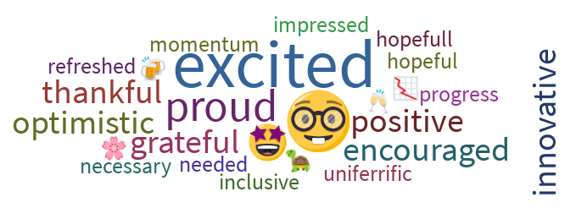
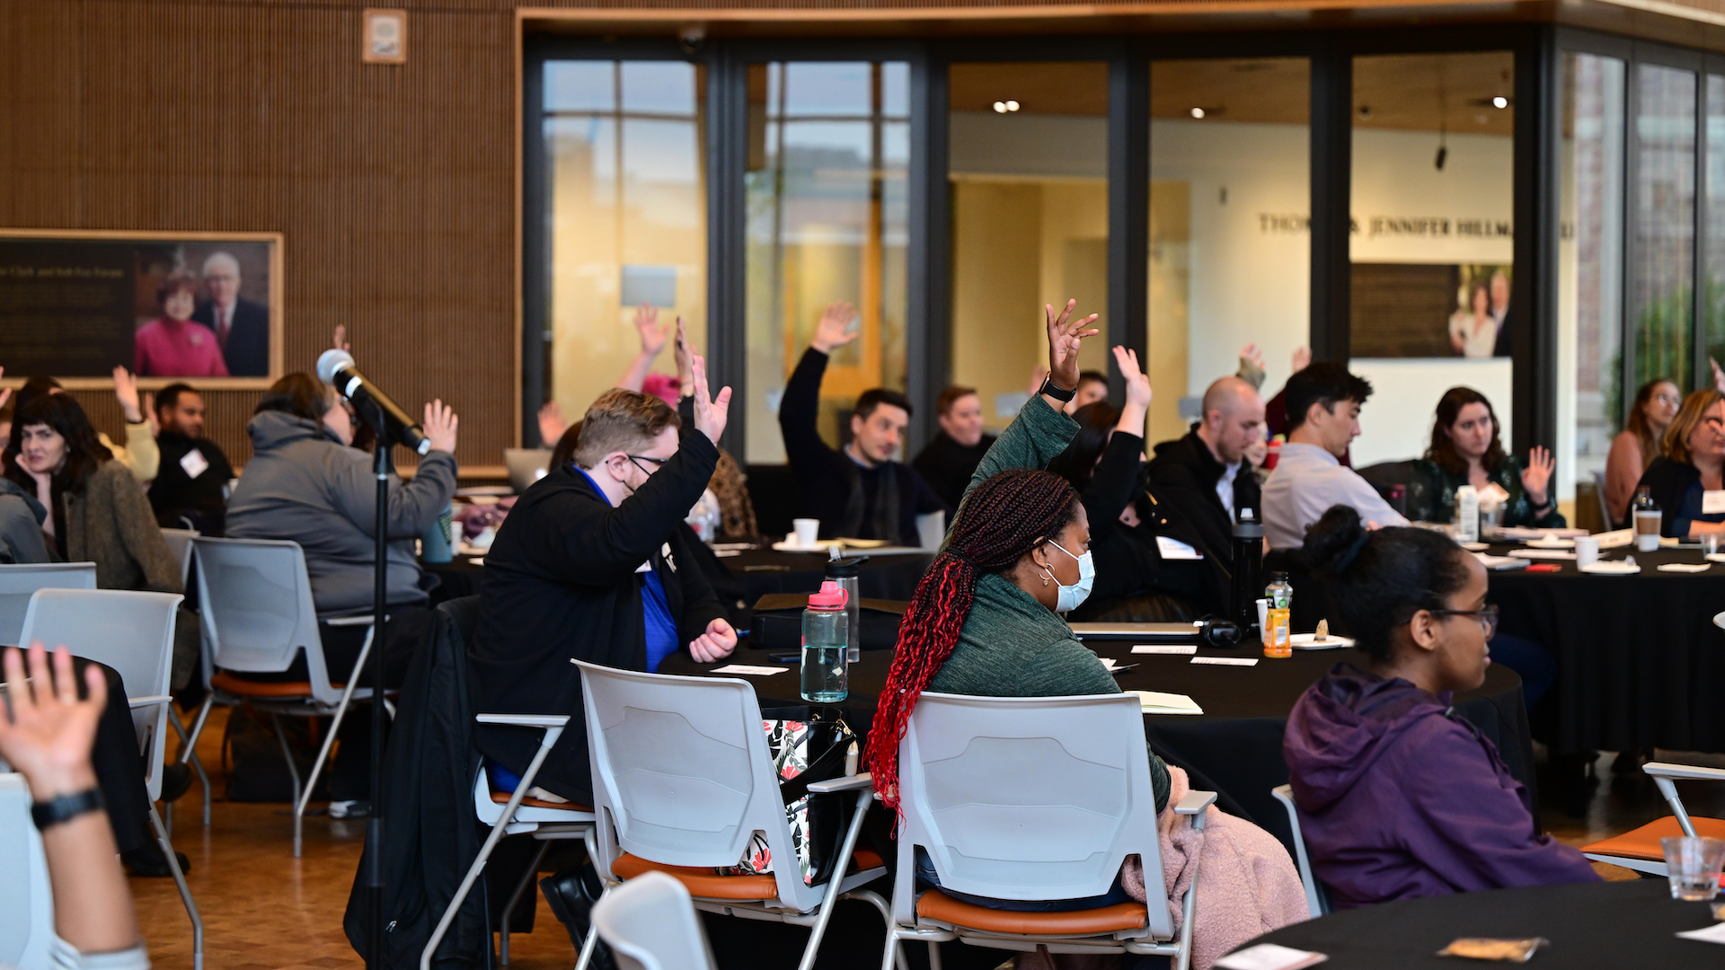


Slide 17



Slide 18
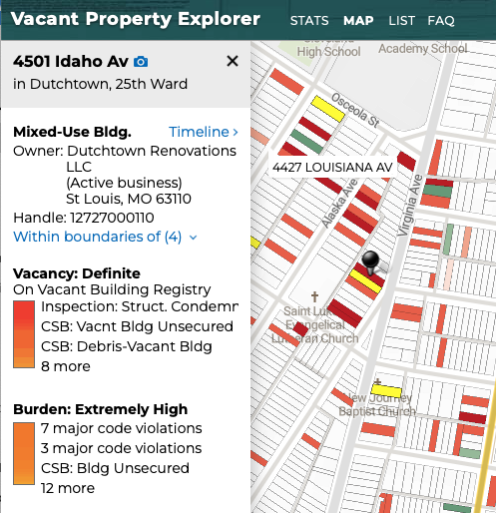
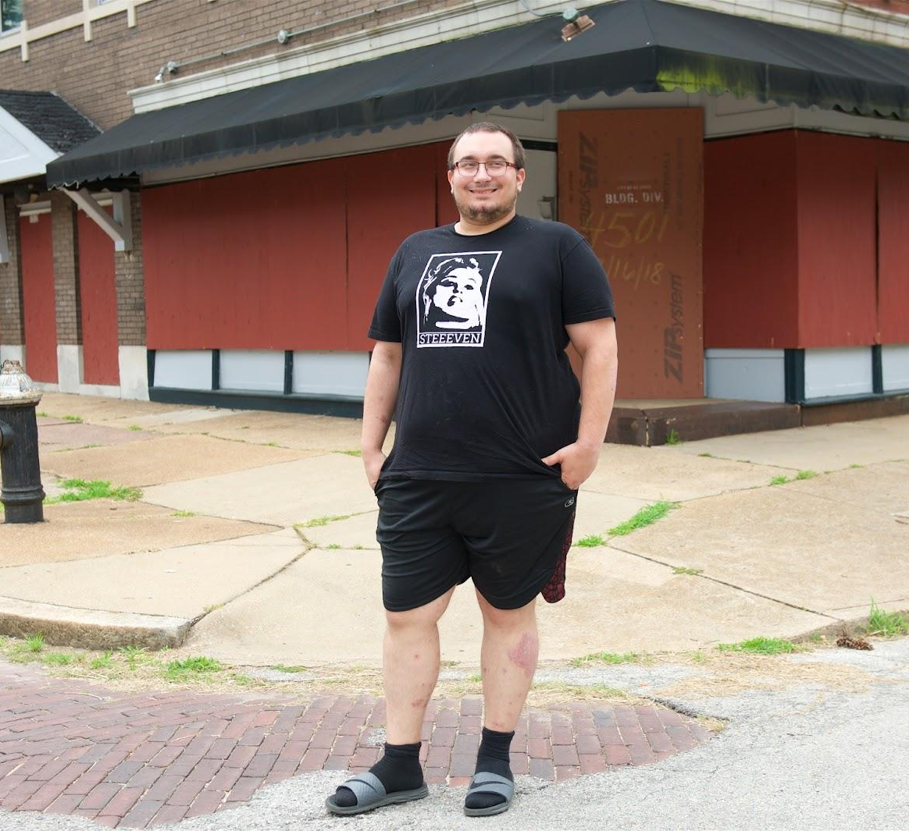
Experiential / Mixed Methods Data Tools?
“This used to be a convenience store when I was a kid, but it’s been gone since longer than I was old enough to remember… just recently they boarded everything up.”
stlvacancytools.com
Small Business
63111
Municipal Services
Vacancy
Read more stories about experiences with vacancy in St. Louis City
Resource: Guide to Addressing Vacant Properties in St. Louis
Notes:
Sketch exploring what it may look like to link the two, exploring the depth, context, and cross-sector nature of community challenges beyond concrete data points.
Prioritize “Read a Story”
Quant/spatial data only appears after clicking on “Tag”
High level / parent tags vs. more detailed child tags
Connecting to additional resources, including more qual data

Slide 19
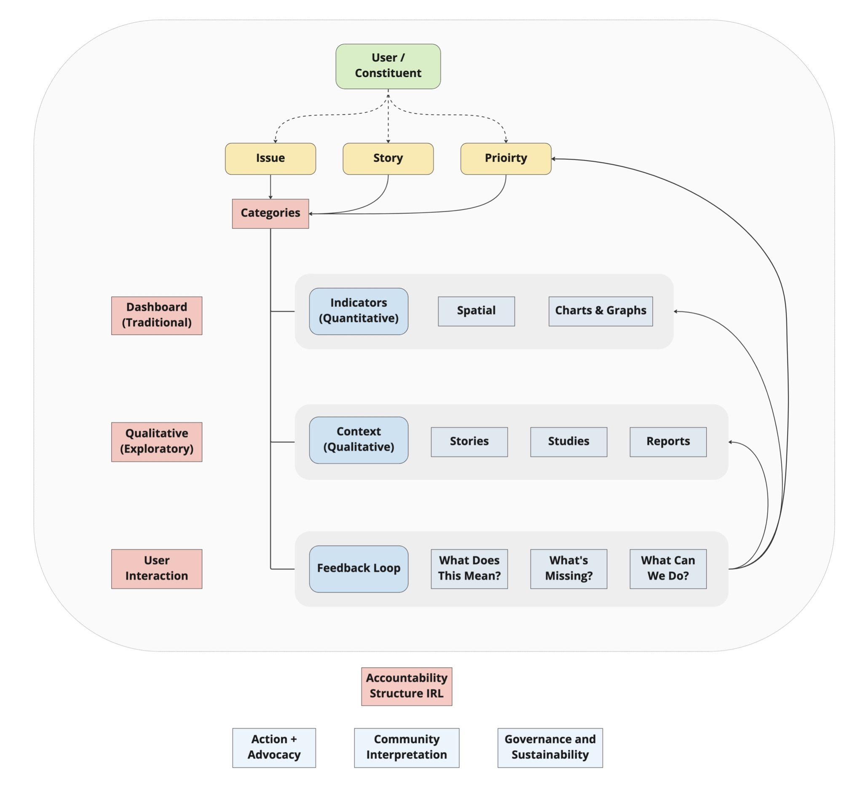
Curating Local Data + Information For Community Action

Slide 20

Paul Sorenson, Co-Director sorensonp@umsl.edu

